Slide 1

Advanced Java Programming
Topic: Parallel Stream
By
Arvind Kumar
Asst. Professor, LPU

Slide 2
Stream characteristics
Immutable
Once elements are consumed they are no longer available from the stream.
Can be sequential (default) or parallel

Slide 3
Parallel Stream
Parallel streams split the elements into multiple chunks, process each chunk with different threads, and (if necessary) combine the results from those threads to evaluate the final result.
May provide better performance
Map/Reduce in the small
Fork/join is great, but too low level
  Stream uses fork/join under the hood
Many factors affect performance
  Data size, decomposition, packing, number of cores
Unfortunately, not a magic bullet
  Parallel is not always faster

Slide 4
Reduction Operations
Reduction operations are used to reduces the stream to a single value.
reduce( ) can return a value from a stream based on any arbitrary criteria
Optional<T> reduce(BinaryOperator<T> accumulator)
T reduce(T identityVal, BinaryOperator<T> accumulator)
<U> U reduce(U identityVal, BiFunction<U, ? super T, U> accumulator , BinaryOperator<U> combiner)

Slide 5
Reduction Operations
It is important to understand that the accumulator operation must satisfy three constraints. It must be
Stateless
Non-interfering
Associative

Slide 6
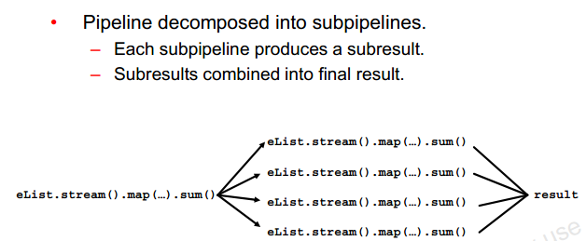
Decomposing and Merging

Slide 7
Collecting
It is used to obtain a collection from a stream.
<R, A> R collect(Collector<? super T, A, R> collectorFunc)
<R> R collect(Supplier<R> target, BiConsumer<R, ? super T> accumulator, BiConsumer <R, R> combiner)

Slide 8
Collector Interface
Collector interface is declared in java.util.stream
interface Collector<T, A, R>
The Collectors class defines a number of static collector methods that you can use as-is.
static <T> Collector<T, ?, List<T>> toList( )
static <T> Collector<T, ?, Set<T>> toSet( )

Slide 9
Collectors Class
groupingBy(Function<? super T,? extends K> classifier)
A "group by" operation on input elements of type T, grouping elements according to a classification function, and returning the results in a map
partitioningBy(Predicate<? super T> predicate)
Partitions the input elements according to a Predicate

Slide 10
Parallel Streams and Performance
Only if the operations are
performed on a significantly large number of elements,
computationally expensive, and
the data structures are efficiently splittable,
you will see performance improvements with parallel streams; otherwise, execution with a parallel stream may be slower than with sequential streams!

Slide 11


